Slide 1

Design & Development
Colton Wedell
5/20/2020

Slide 2
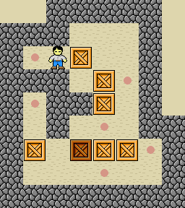
Background
Inspired by a Japanese puzzle game, Sokoban
2D top-down game
Push crates onto marks on floor
Combines elements of Sokoban with a traditional platformer
Called Shift because it uses the Shift key to shift gravity modes

Slide 3
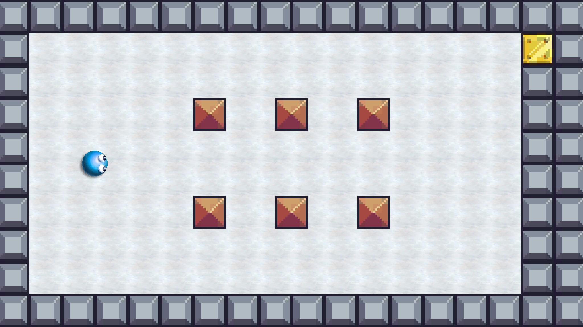
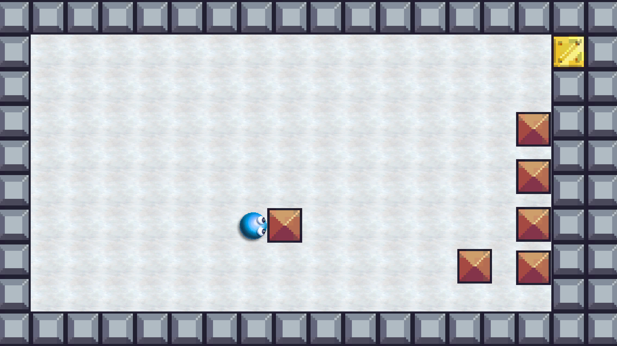
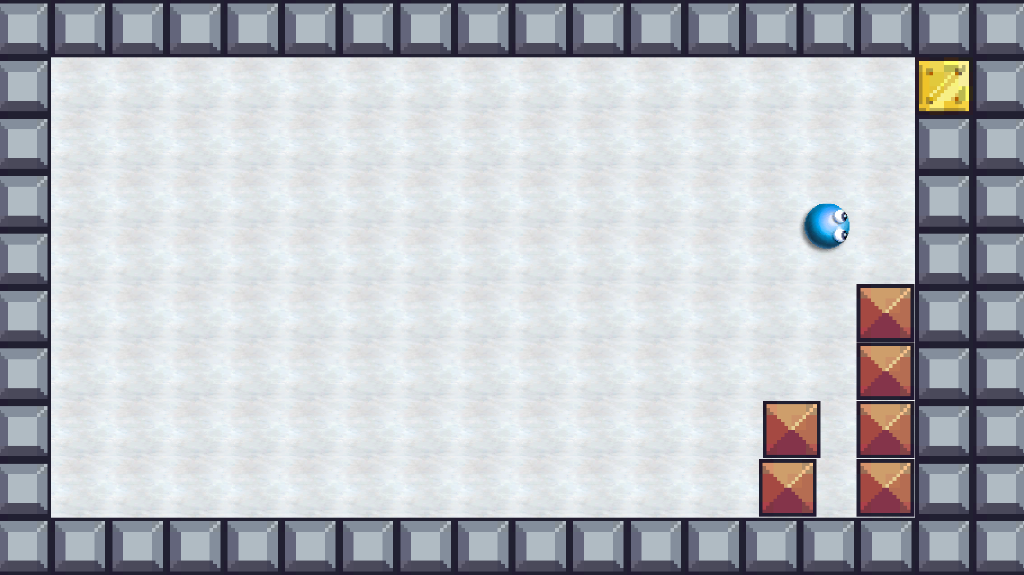
Gameplay
Start each level in antigravity (2D top-down environment)
Push boxes to desired locations
Press Shift to turn on gravity (2D side view environment)
Play through level like a platformer to reach gold block (goal)
Level 1 initial position
Arranging the blocks as desired
Completing the level as a platformer

Slide 4
Features
Main feature: specialized blocks with different animated functions
Jump block: spring-like device, player jumps extra high (also works on blocks)
Crumble block: will dissolve one second after being touched by the player
Reverse gravity block: flips gravity upside down (fall to ceiling) after being touched by the player; also inverts player jumping and the jump block (can jump upside down)
All of these features work only in the gravity-enabled platformer mode
Jump block
Crumble block
Reverse gravity block

Slide 5
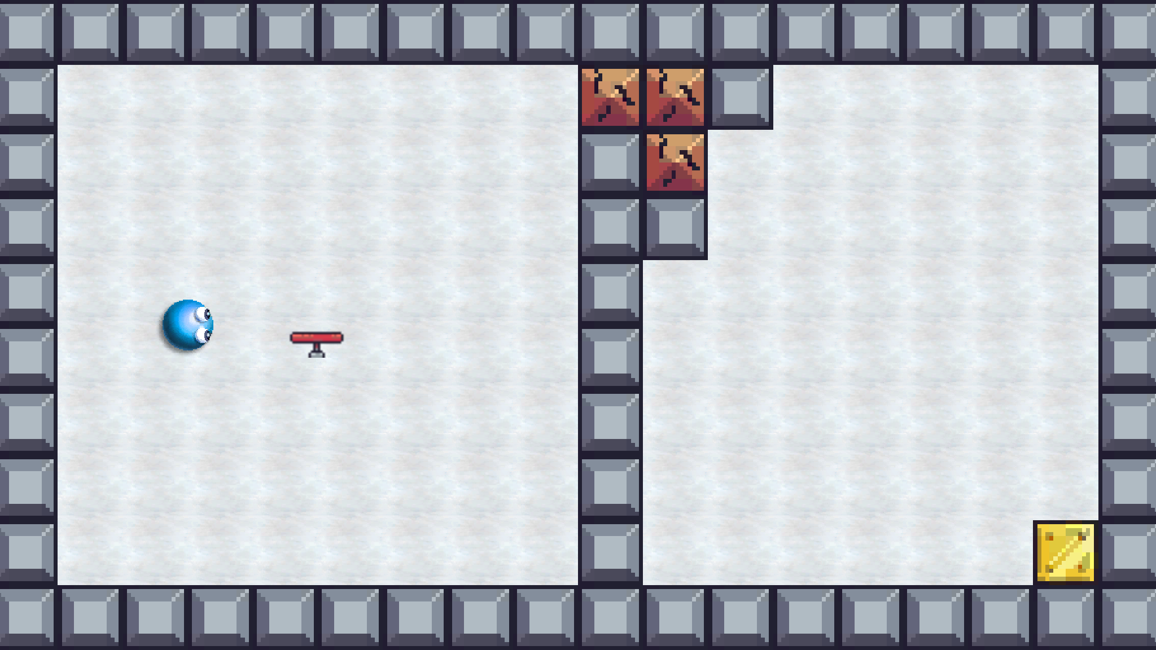
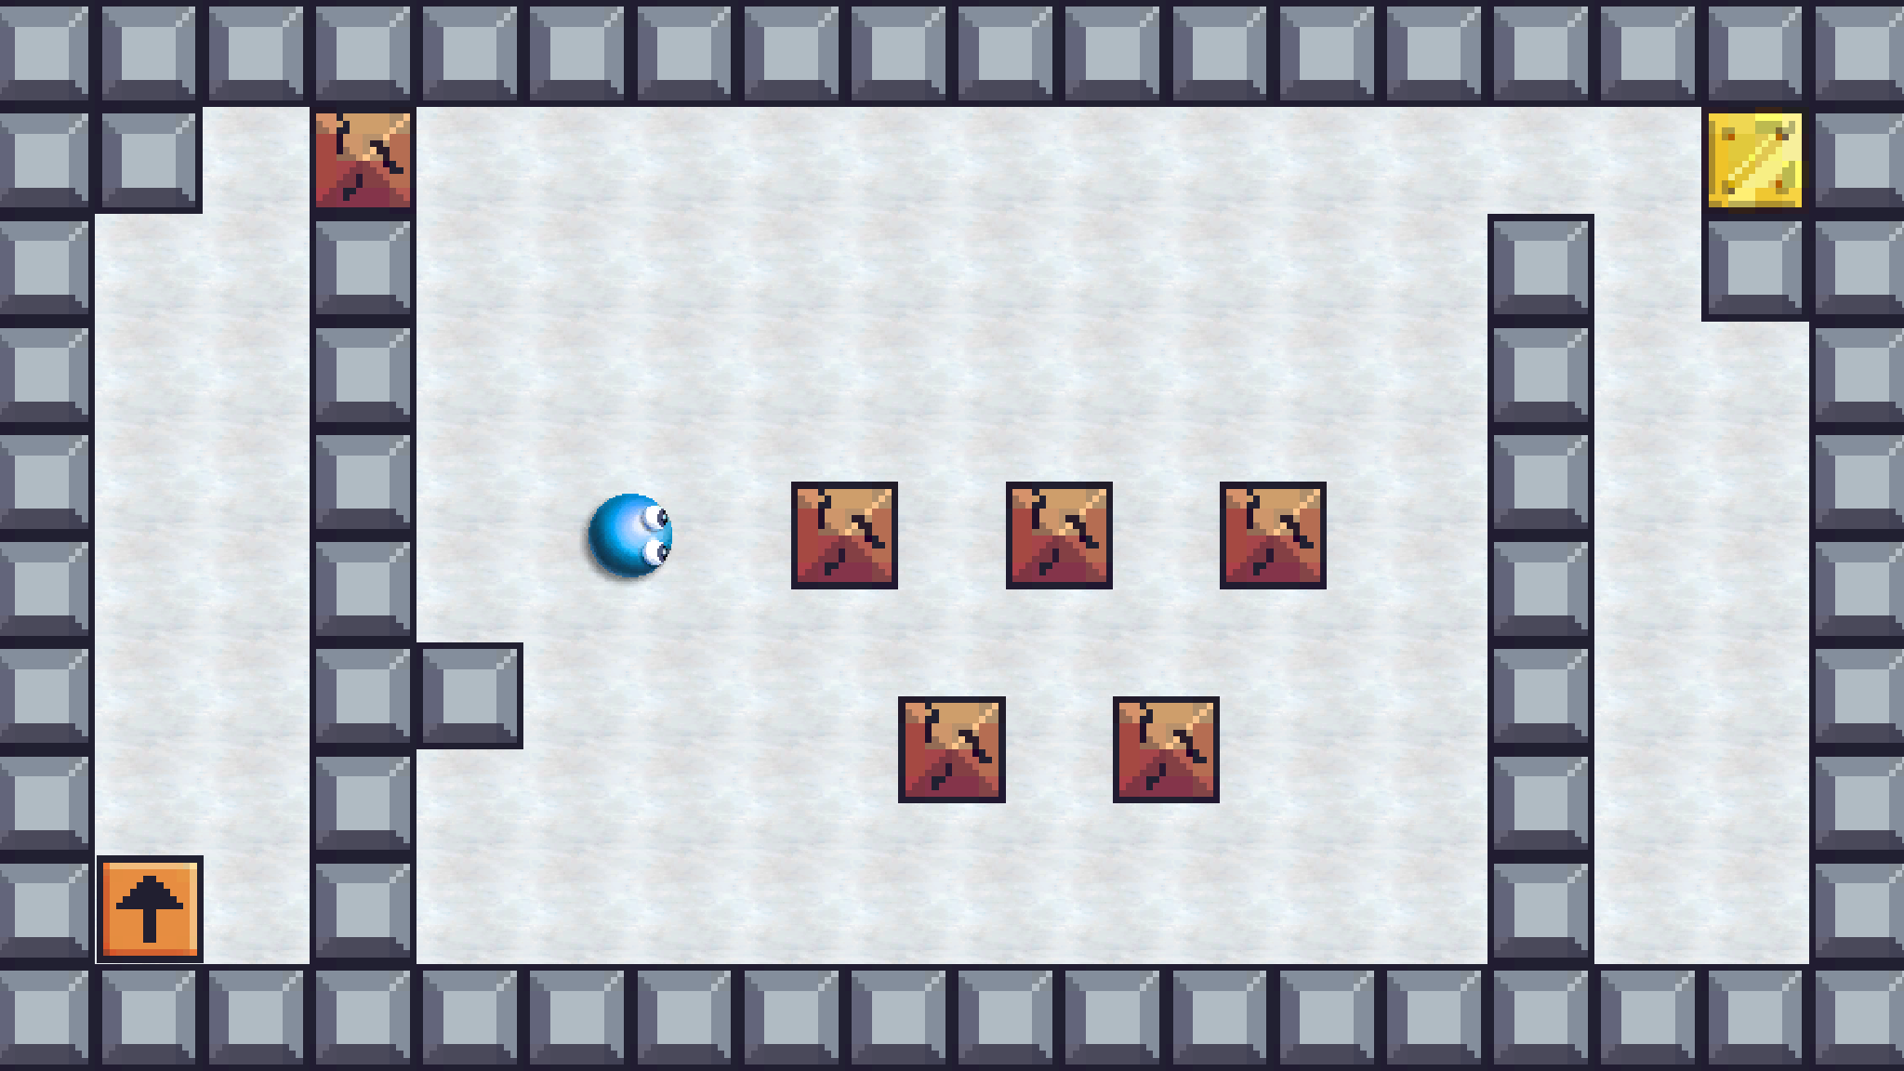
Development Steps
Level 1
Chose game theme and art
Created player mechanics (first gravity mode, then antigravity mode)
Developed specialized blocks (in the order of the previous slide)
Added block animations and sound effects concurrently
Built main menu, submenus, and pause menu
Added button click logic and sound effect concurrently
Inserted background music
Designed three levels to showcase all specialized blocks
Level 2
Level 3

Slide 6
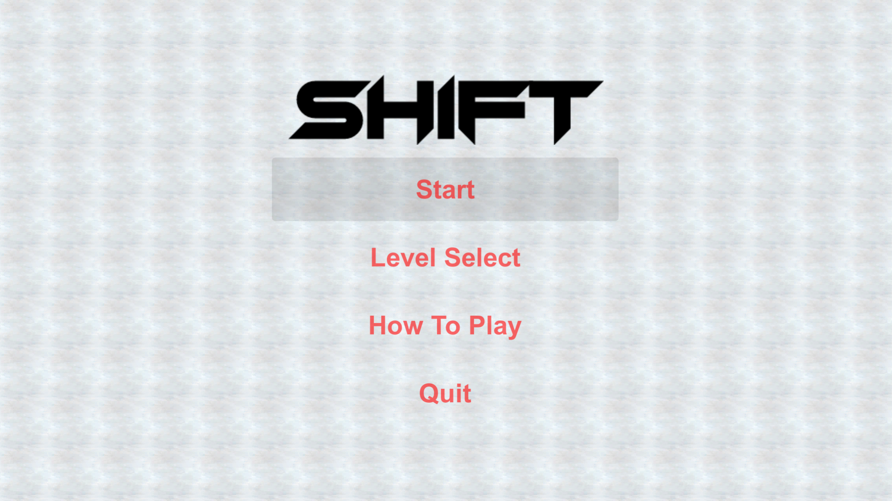
Future Development
Prioritize cleaning up physics of collisions
Move player in antigravity using something other than transform.position, as this is external to the physics engine and makes collisions buggy
Introduce mechanic to keep player from “cheating” – going to the goal at the start without attempting to solve the puzzle
Add more levels
Current levels are more of a tech showcase than an actual puzzle
Add new specialized blocks and/or player features with unique mechanics
Main menu with Start button mouseover

